Slide 1
St Anne's College
Catering Brochure 2022

Slide 2
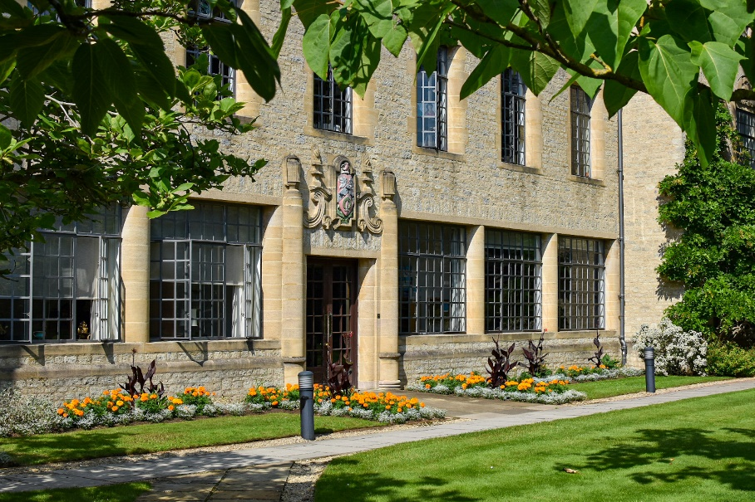
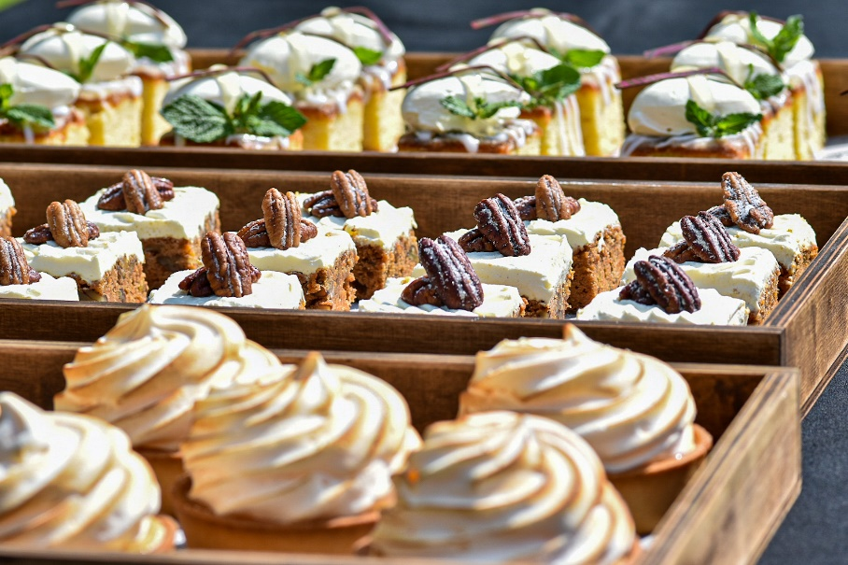
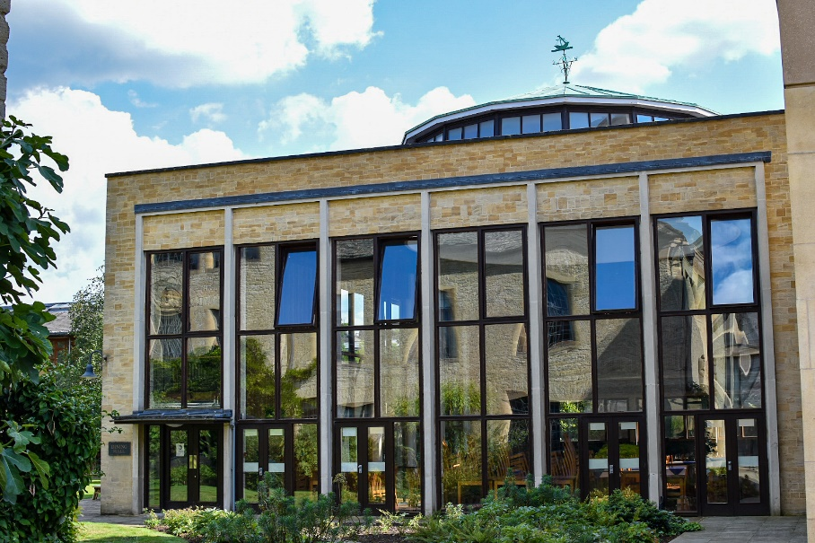
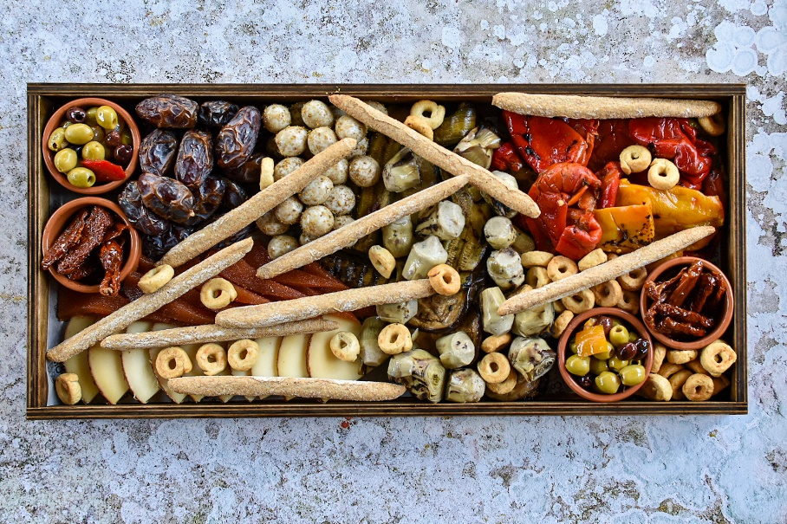
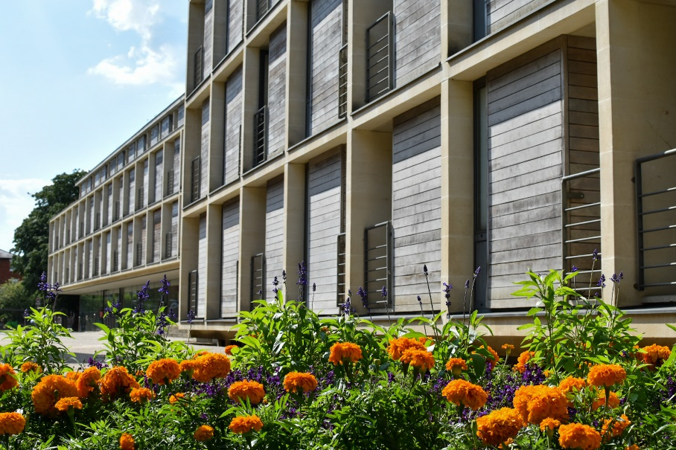
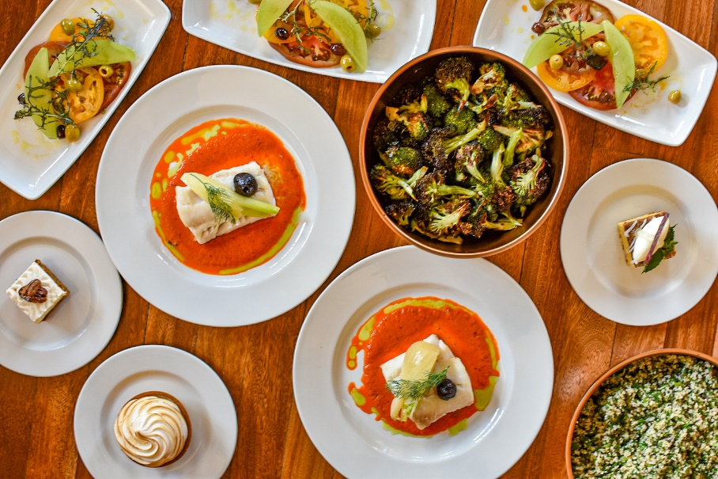
St Anne’s College – Catering
CONTENTS
Catering introduction.
Sustainability.
Working Breakfasts.
Cold Grazing.
Hot Grazing.
Working Lunches.
Family Service Dinners.
Pintxos & Nibbles.
Fine Dining.
Barbecues.
The Head Chef’s Tempters!
STACs.
College Bar.
Wine List.
@st_annes_kitchen

Slide 3
St Anne’s College – Catering
At St. Anne’s College we are very aware of the need to look after the environment. We are mindful of sustainability and work towards an ethos based around seasonal food and sustainably sourced ingredients.
Our chefs pride themselves in creating delicious & imaginative seasonal menus with emphasis on fresh ingredients and sustainability, sourced locally whenever possible.
As well as menus containing meat, fish and dairy our pack contains menus that offer a plant based option not only for anyone who chooses to eat vegan but for anyone looking to cut down on meat intake and production.
From large events to small private dinners, our dedicated and experienced team of Chefs are keen to advise and create your menu using what’s available to them at the time and you to enjoy food of the highest quality and our friendly, courteous front of house team will offer advice on matching wines too.
Please inform us of any food preferences, allergies or intolerances as soon as possible and we will endeavour to accommodate your requirements.
Please note – As our priority is sustainable sourcing and we are committed to using fresh, seasonal produce whenever possible, we require confirmation of final numbers, menu choices and dietary requirements 14 days in advance of your event.
If you are organising a conference or a meeting we can offer working breakfasts, hot or cold grazing tables, working lunches, barbeques, fine dining lunches and dinners as well as morning coffees, afternoon teas and drinks receptions, these can all be catered for in various locations around the College site.
Location of meals especially lunches may vary and will be advised on the day of your event of the location – Dining Hall, Ruth Deech Building (RDB) or Quad Marquee(summer only).
The main dining areas are shared spaces with all other guests and separate tables will be reserved for each group. There is an additional fee for exclusive use of these areas and the conference and events team will be happy to advise on this.
If staying with us as a conference or B & B guest, you can also enjoy our delicious home cooked breakfast that varies daily – this will be available from Dining Hall, unless you have booked a working breakfast and our Conference & Events team will advise the private location at the time of booking.
STACS is our coffee shop onsite which can be booked by conference organiser in advance for delegates to ‘chill out’ in the evenings and where we pride ourselves in offering homemade pizzas made with our sourdough bases which are sustainably sourced by Italian food specialist Stefano Vallebona. Also available are coffees and a small range of wines and beers. (Please note – there will be a £50 deposit for this option that will be refunded if delegates make purchases to this amount)
College Bar – this like STACS can be booked by conference organisers in advance for the evening where delegates can relax over a pint or G & T whilst challenging colleagues to a game of table football or quietly reflecting on the days course. (Please note – there will be a £50 deposit for this option that will be refunded if delegates make purchases to this amount)The bar can also be pre – booked for a drinks reception before dinner too.
Roof garden – This area can be pre booked (exclusive use – 15 – 20 people max.) for that unique experience of wining/dining alfresco whilst enjoying views over the surrounding area. We can offer drinks reception, hot and cold grazing tables, afternoon tea (scones, jam and cream).
We have many more options available so please take the time to browse through our Catering Conference Pack and hope you find something here to suit your needs, if you have any questions about anything our professional catering team are happy to advise and help you on what would work well for your event.
Regular catering choices include:-
· Breakfast – self-service from the Dining Hall – 07.30 – 09.00hrs – a selection of both hot and cold breakfast items available
· Tea, coffee & biscuits – served close to your meeting room at times of your choice.
· Lunch – Hot or cold grazing table – served from 1230 – 1330hrs
· Dinner – Family service – served at your table at 19.00hrs
· Drinks Receptions and Formal Dinners
· Wines to accompany lunches and dinners as required.
· Supplementary items – Pastries, scones, cakes, fruit basket/platter, fruit juice are also available on request.
@st_annes_kitchen

Slide 4
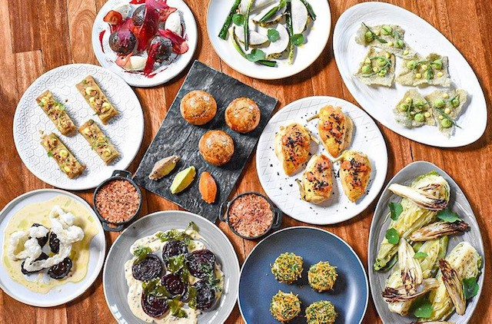
Sustainability at St Anne’s
Local produce
We champion local produce using it wherever possible. We work closely with our suppliers to understand the origins of produce delivered to us.
Fresh eggs
All of our fresh eggs are British free-range from Mayfield Farm in Oxfordshire just 11.4 miles away.
Coffee
Bean Bags Coffee Company supplies our coffee, they source Fairtrade organic beans from Papua New Guinea
Keep cups
We offer keep cups. There is enough plastic in 20 disposable cups to make 1 keep cup.
Meat
The meat we use is mainly sourced from local family run butchers Alden’s. We only source red meat reared in the UK, some of which is reared on the Alden’s family farm where they graze on ancient Thames side pastures. The poultry we use is also UK reared. Only corn fed chicken and guinea fowl is imported from France.
Cooking oil
Our cooking oils are supplied by Olleco, industry leaders in sustainably reusing used oils for biodiesel. The exceptional quality of their biodiesel can completely replace fossil-derived diesel giving an 88% reduction in greenhouse gases.
Imported vs UK produce
We consider miles traveled by produce not only for environmental reasons but the quality of the produce after the journey. If something cannot be produced in the UK then this is when we look to imported produce with aim to keep the origin as close to the UK as possible.
Fish
Our seasonal fresh fish is supplied by Kingfisher Brixham who do much of their sourcing from day boats on the south coast and the Brixham, Plymouth, Looe and Newlyn markets. This enable's full traceability from vessel to our kitchen.
@st_annes_kitchen
Milk
We only use milk that is British Red Tractor certified.
Chocolate
The chocolate we use in our desserts is recognised for 100% sustainable farming and is cocoa horizons certified.
Italian deli
Our Italian produce comes from Table@Vallebona. Stefano Vallebona sources only from independent artisan producers around Italy. Many the same his great grandfather used in the 19th century.
Cheese
We use British cheeses from The Jericho Cheese Company who source only from independent cheese producers around the UK and Italian cheeses from Table@Vallebona who select cheeses from independent artisan producers.
Garnish
OX3 Greens, Oxfords first vertical farm, supply us with herbs used to garnish certain meals. Only 3 miles from the city centre, their carbon footprint is minimal.
Kitchen
Our main kitchen where 95% of the food is cooked and prepared is fully electric. Powered by Scottish Power’s 100% renewable sourced energy tariff.

Slide 5
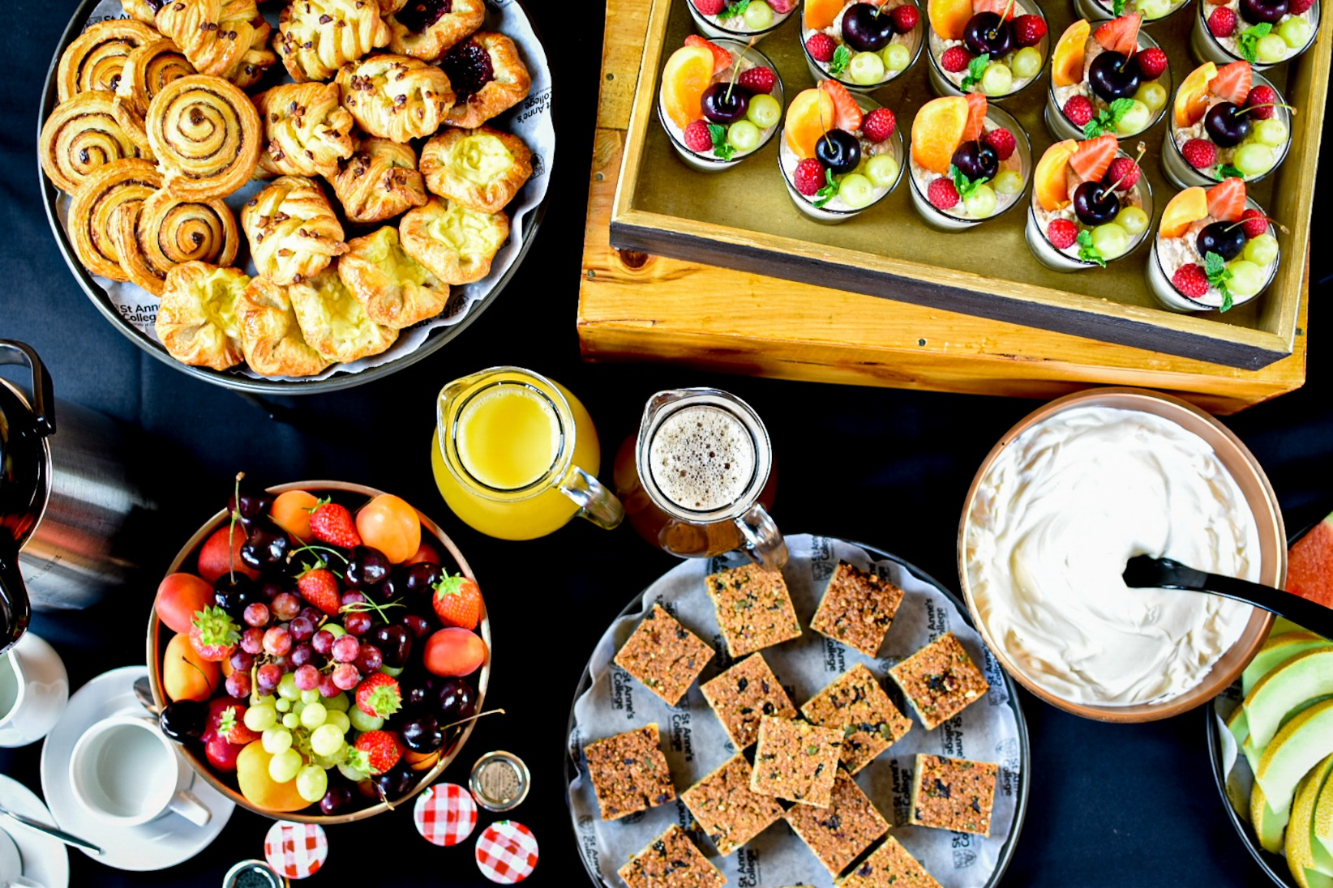
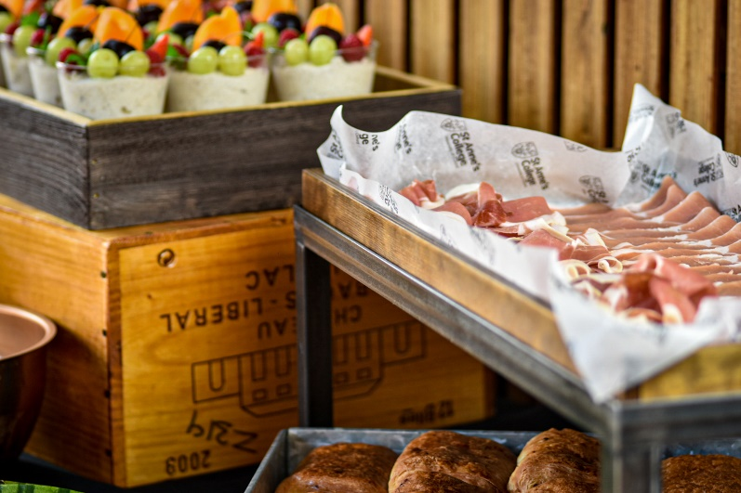
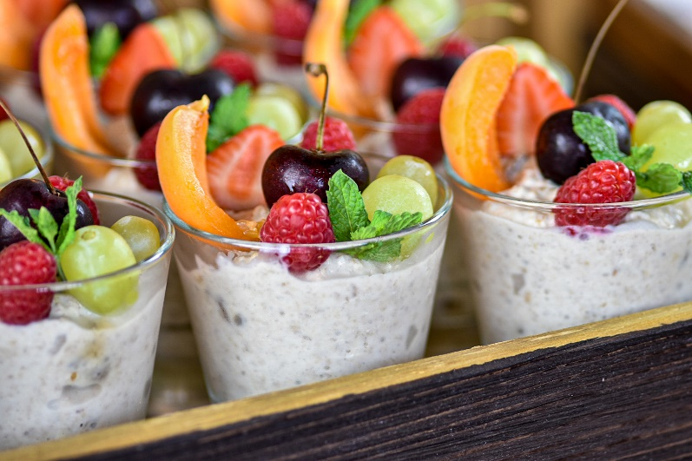
Working Breakfasts
This is a continental breakfast available for you to have a private working breakfast
Minimum of 15 people - £13.34pp
Sample Menu
Danish pastries and croissants.
Bread selection.
Cooked and cured meat selection.
Honey, jam & marmalade selection.
Greek yoghurt.
Bircher museli.
Homemade granola bars.
Fresh fruit platter.
Fruit juices.
Tea and coffee.
@st_annes_kitchen
All menus are subject to VAT at the prevailing rate

Slide 6
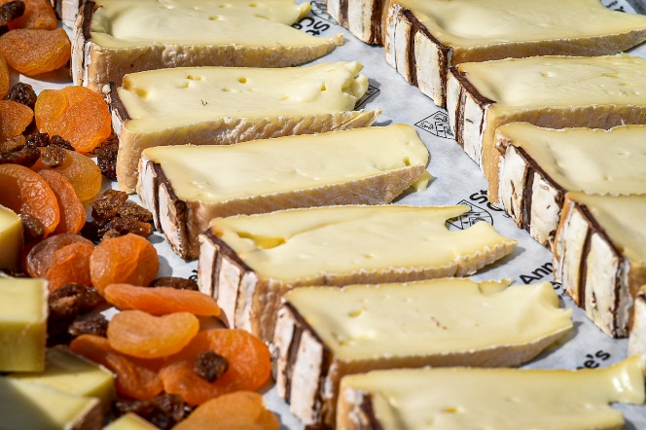
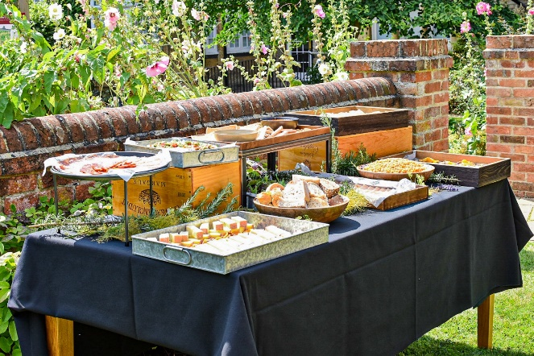
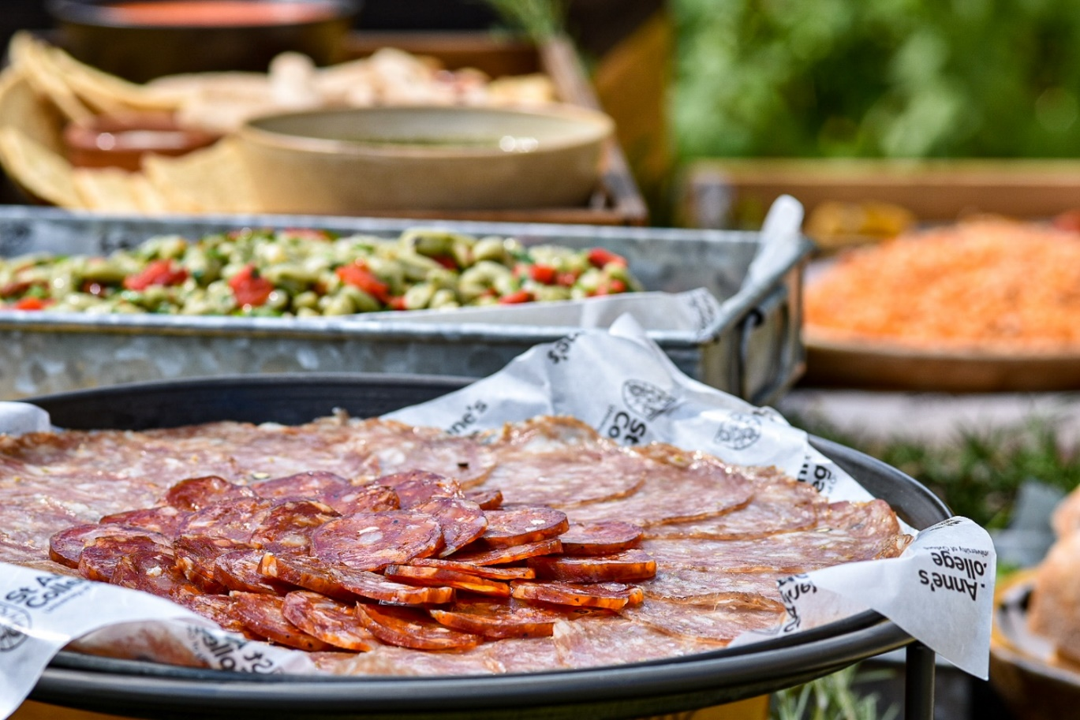
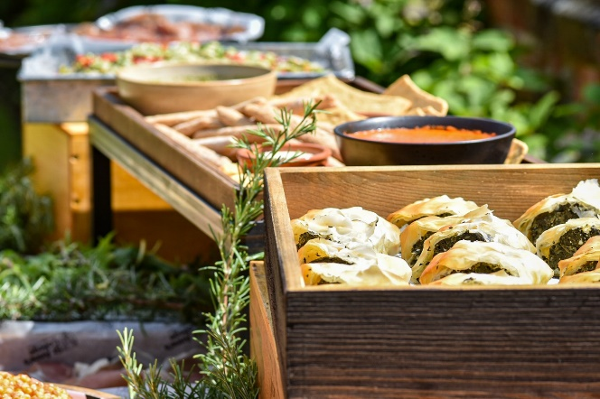
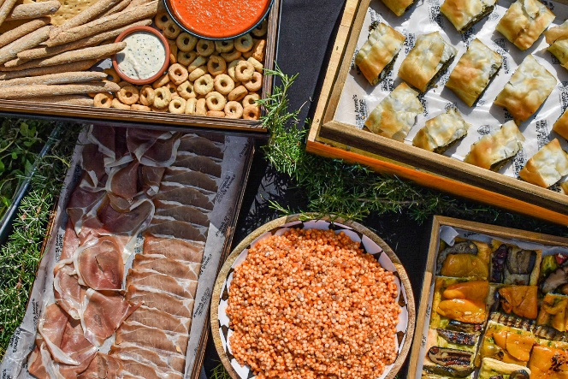
Cold Grazing
Consists of a selection of cold meats, cheeses, salads, breads, condiments
Minimum of 15 people - £22.24pp
Sample menu
Cooked and cured meats, including produce sourced locally from butchers and producers as well as produce sourced from independent artisan producers around Italy.
Cheeses including produce sourced around the UK by Jericho Cheese Company, Italy by Table at Vallabona’s and France by The Oxford Cheese Company.
Vegetarian and vegan options made where possible with locally sourced produce.
Complimenting seasonal compound salads.
Mixed leaf salad.
Variety of fresh and dried artisan breads.
Table condiments such as sauces, pickles & chutneys.
Supplementary
Homemade desserts – additional £4.45pp
Served with fruit juice, still & sparkling water, coffee and a selection of tea
@st_annes_kitchen
All menus are subject to VAT at the prevailing rate

Slide 7
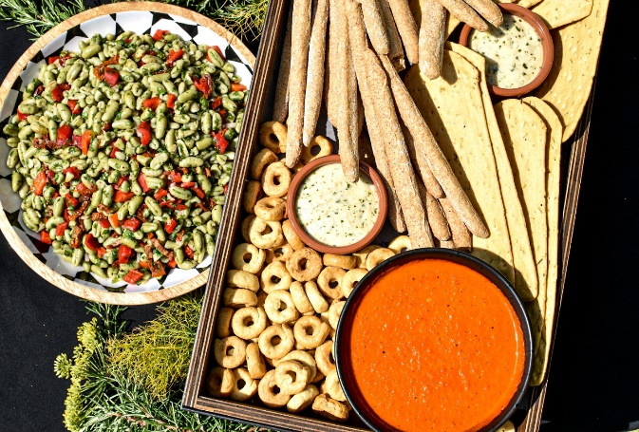
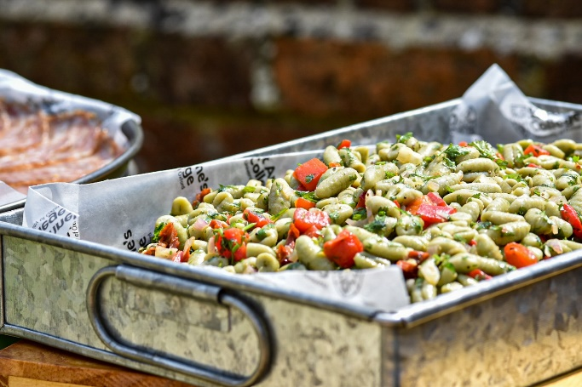
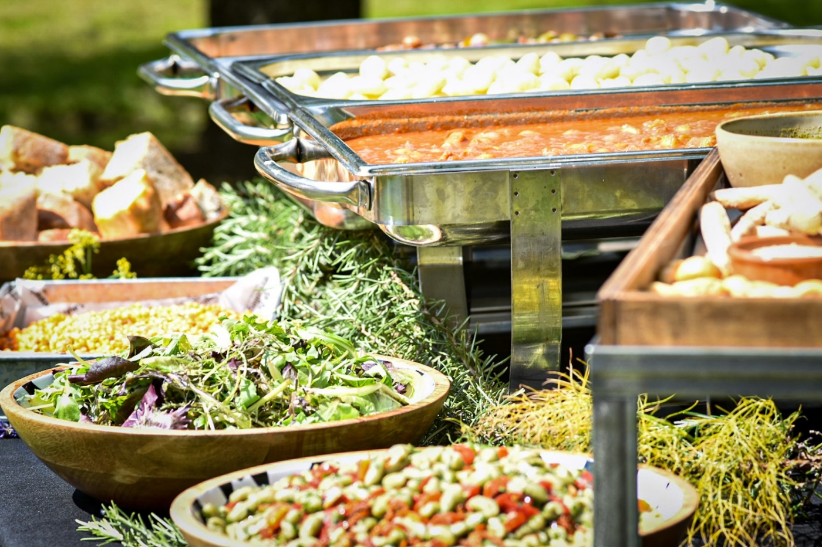
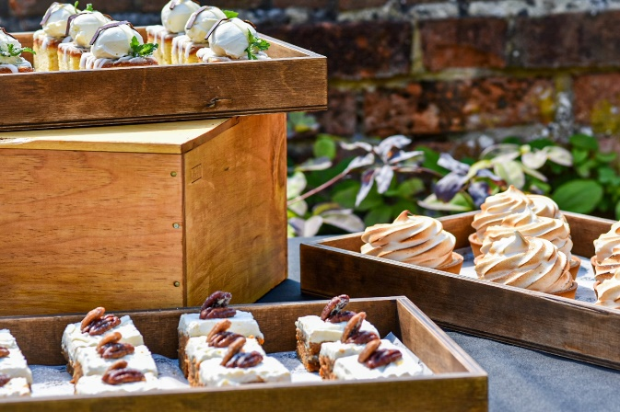
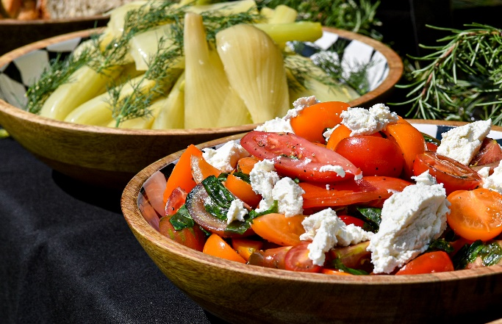
Hot Grazing
Consists of meat and vegetarian hot item complimented with a
selection of salads, breads, condiments
Minimum of 15 people - £22.24pp
Sample menus
Pumpkin & apricot tagine, toasted almonds, pomegranate couscous.
Lamb & apricot tagine, toasted almonds, pomegranate couscous.
Falafels.
Complimenting seasonal compound salads.
Mixed leaf salad.
Variety of fresh and dried artisan breads.
Table condiments such as sauces, pickles & chutneys.
Or
Aubergine passata & gnocchi ragu with gremolata.
Chicken passata & gnocchi ragu with gremolata.
Arancini.
Complimenting seasonal compound salads.
Mixed leaf salad.
Variety of fresh and dried artisan breads.
Table condiments such as sauces, pickles & chutneys.
Supplementary
Homemade desserts – additional £4.45pp
Served with fruit juice, still and sparkling water, coffee and a selection of teas
@st_annes_kitchen
All menus are subject to VAT at the prevailing rate

Slide 8
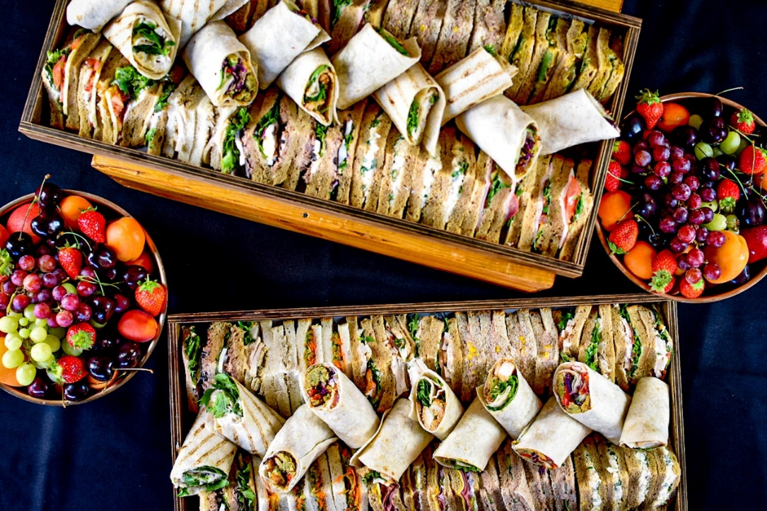
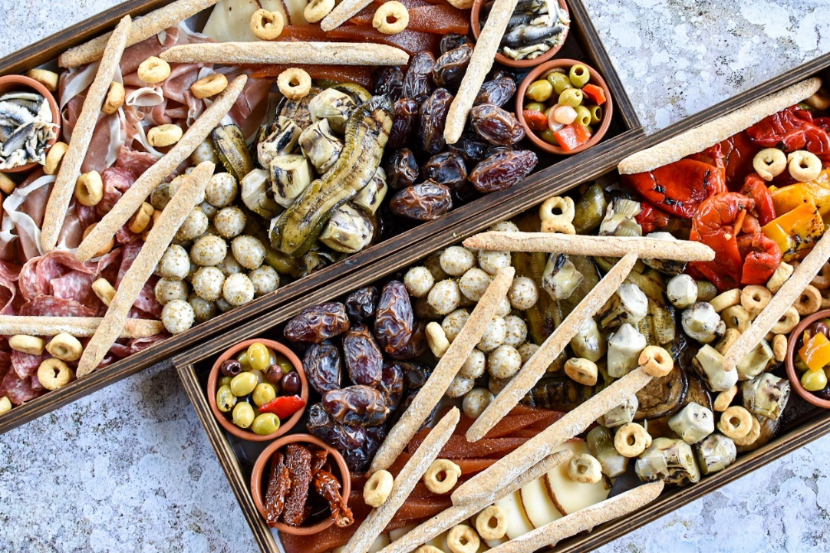
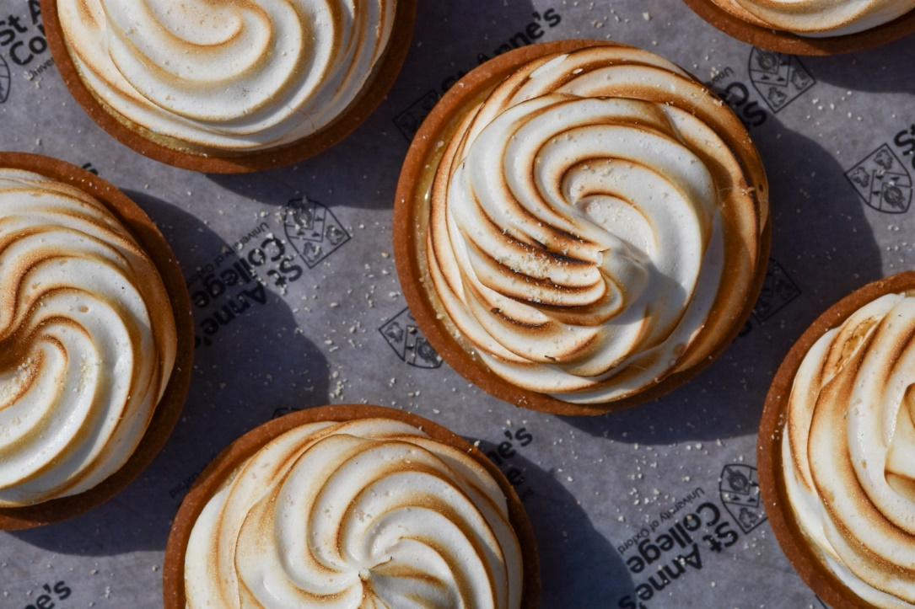
Working Lunches
Sandwich and wrap trays
Minimum of 15 people - £13.34pp
A selection of sandwiches and wraps and served with selection of fresh fruit, fruit juice, still and sparkling water, coffee and a selection of teas
Tapas trays
Minimum of 15 people - £16.68pp
A meat or vegetarian option as standard, including a selection of easy to pick at and mindfully sourced cured meats, marinated vegetables, cheeses, artisan dried breads and such alike. Any special dietary requirements plated or boxed separately. Served with fruit juice, still and sparkling water, coffee and a selection of teas.
Supplementary
Dessert tray – minimum of 15 people - £4.45pp
A selection of homemade desserts.
@st_annes_kitchen
All menus are subject to VAT at the prevailing rate

Slide 9
Family Service Dinner
As the name implies this is a dinner that is laid out on your dining table for you to help yourselves.
Minimum of 15 people - £26.68 for 2 course / £37.84pp for 3 courses
Sample menu - 2 course menu;
Polenta crusted cod with caponata, spinach capunti pasta, wild rocket salad.
Citrus & vanilla yoghurt panna cotta.
Sample menu - 3 course menu;
Cutteslowe tomato, mozzarella & basil salad with black olive crumb.
Sumac grilled chicken breast with dill pickled fennel, pearl couscous & roasted broccoli.
(v) Sumac marinated feta parcel, dill pickled fennel, pear barley couscous & roasted broccoli.
Mango & coconut delice.
2 and 3 course menus are served with still and sparkling water with coffee at the conclusion.
Supplementary
A full winelist is available on request, please ask our Conference and Events team for more details
@st_annes_kitchen
All menus are subject to VAT at the prevailing rate

Slide 10
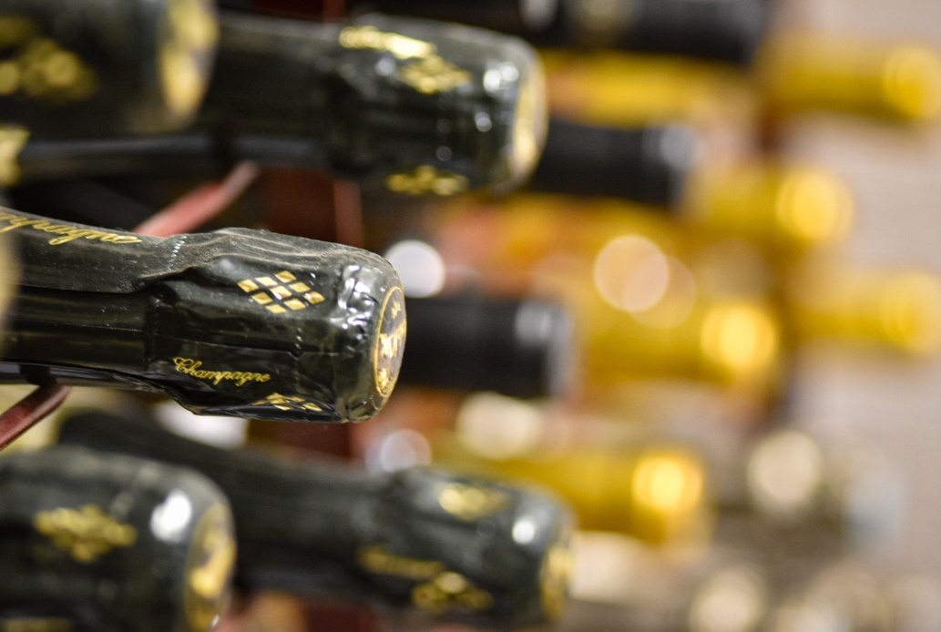
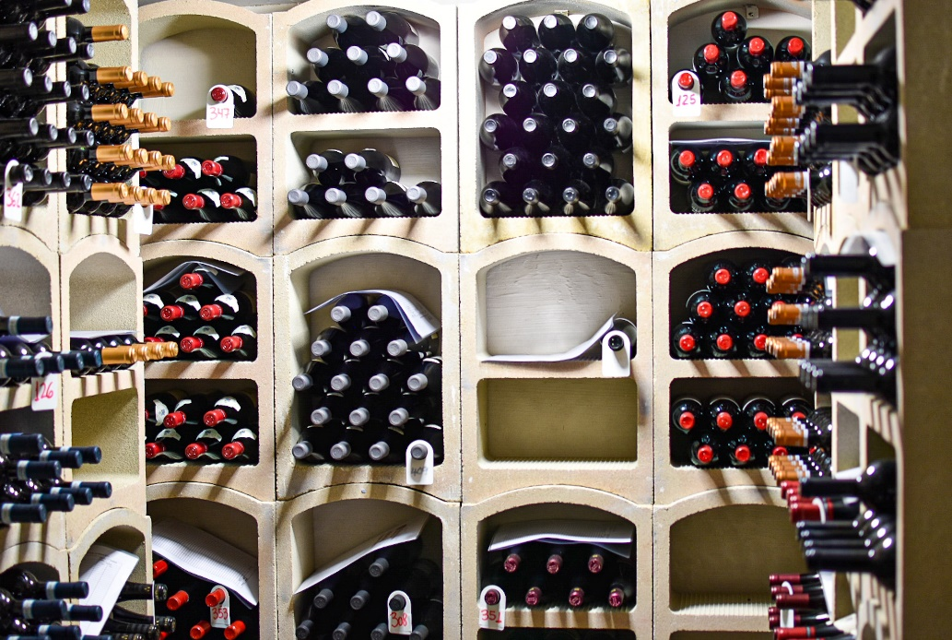
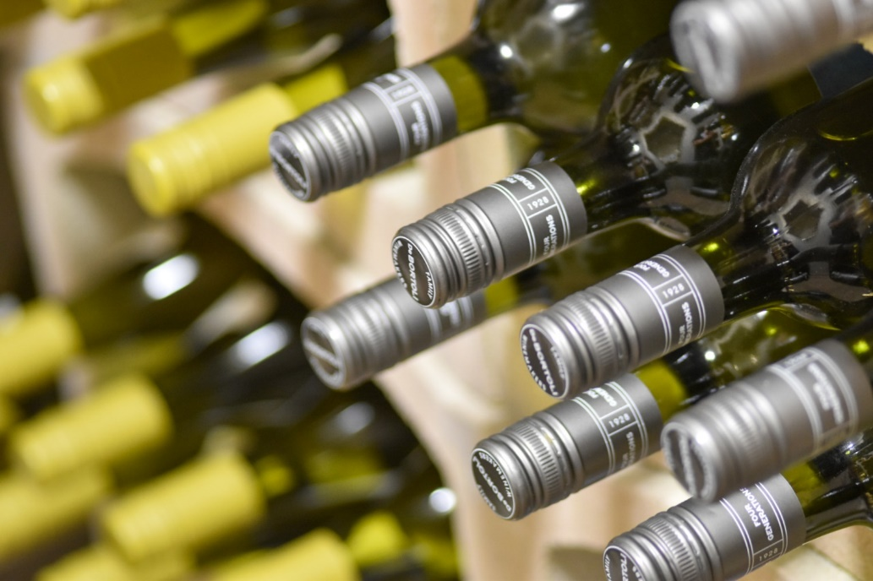
Drinks Reception
A choice of either champagne, sparkling wine or still wine
Champagne reception £30.00/person
Sparkling wine reception £10.00/person
Red and white wine reception - £9.00/person
All receptions include a selection of fruit juice, still and sparkling water and sparkling presse
Supplementary
A selection of beers and ciders can be added to any of the receptions above and will be charged on a sale or return basis.
Heineken Non Alcholic Beer 330ml - £1.67/bot
Beck’s 330ml - £2.92/bot
Beaver Beer 500ml - £3.34/bot
Kopperberg Mixed Fruit Cider 500ml - £3.75/bot
Jug of Pimms 1.5L - £15.84/jug
@st_annes_kitchen
All menus are subject to VAT at the prevailing rate

Slide 11
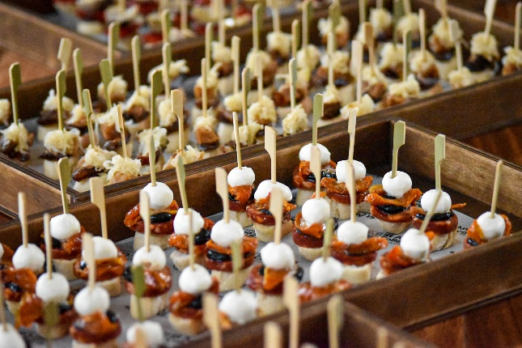
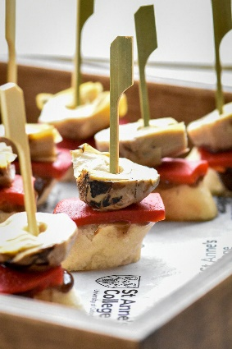
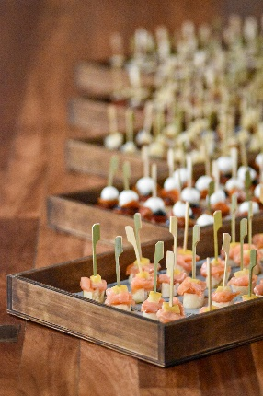
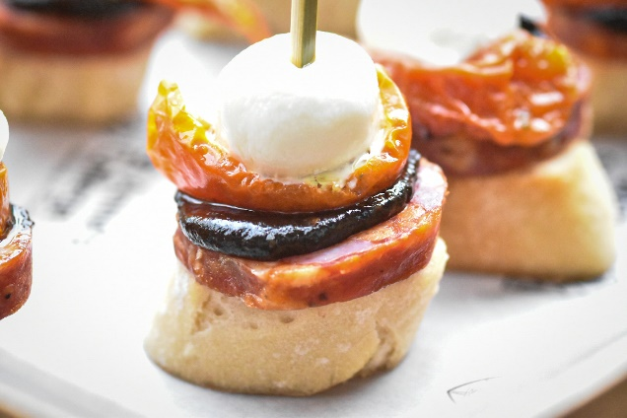
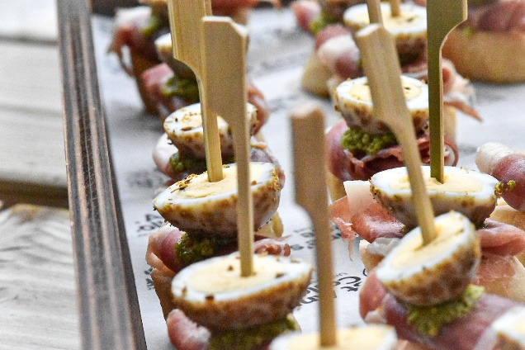
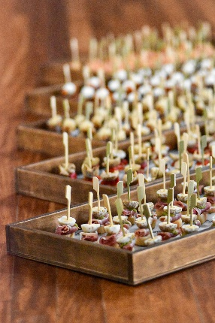
Pintxo’s & Nibbles
Pintxo’s
Minimum of 15 people - £10.03pp for 3 / £16.68pp for 5
A typical Northern Spanish bar snack Pintxo’s are a great way to start a meal with pre dinner drinks or to enjoy during a drink reception. We predominantly serve our Pintxo’s on sourdough baguette topped with ingredients sustainably sourced from the UK and Europe.
Menus to be designed by the chefs on the day of the event.
Sample menu
Fennel salami & olive.
Potato tortilla & artichoke.
Cured trout & whipped goat cheese.
Chorizo & grilled green pepper.
Grilled aubergine & romesco.
Marinated anchovy & roast fennel.
Cured pork shoulder & quail egg.
Manchego & membrillo.
Grilled prawn & pickled red onion.
Nibbles
Minimum of 20 people - £5.58pp
Sample menu
Vegetable crisps
Japanese rice crackers
Spice pumpkin seeds
@st_annes_kitchen
All menus are subject to VAT at the prevailing rate

Slide 12
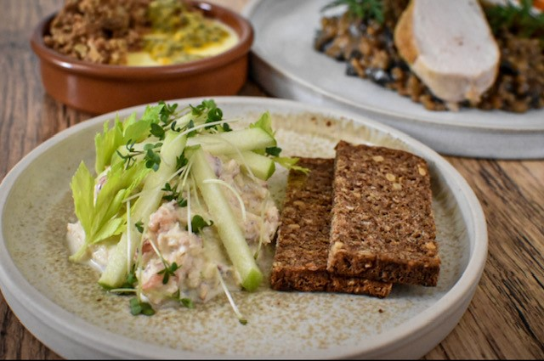
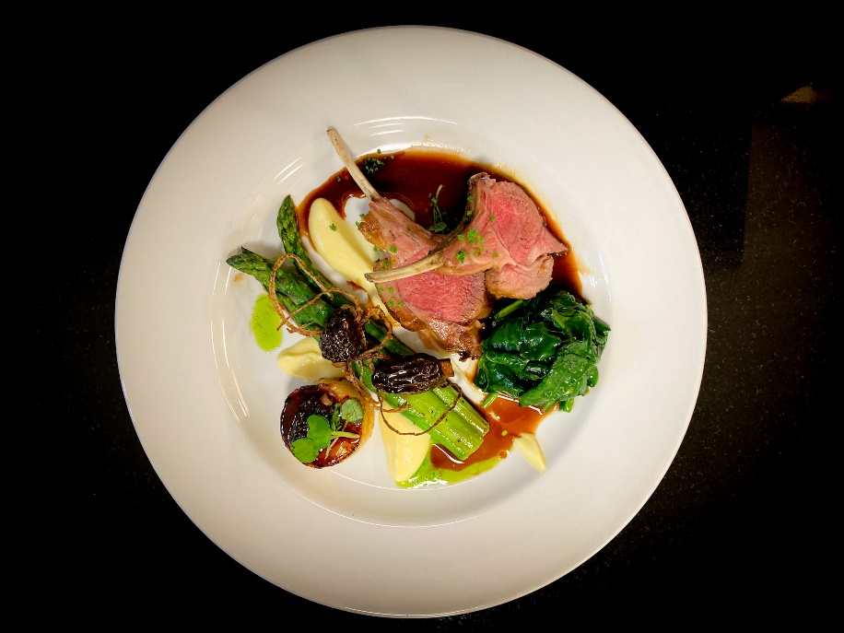
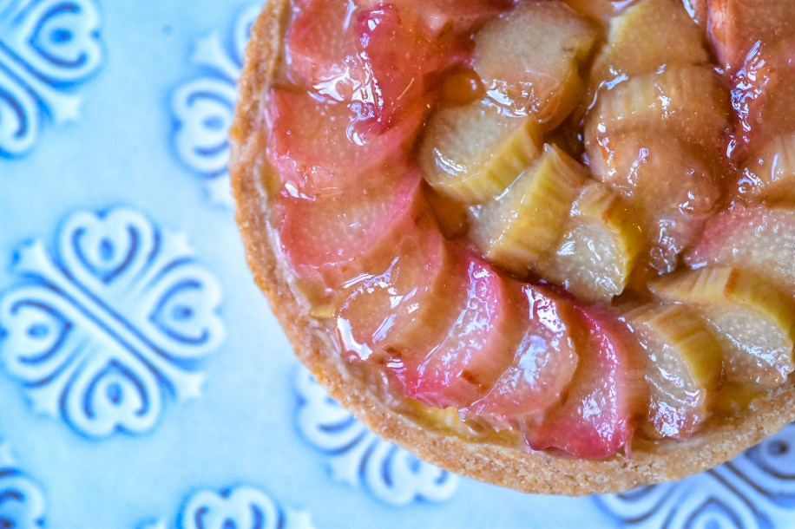
Fine dining
Our menus will vary throughout the year in keeping with seasonal changes and availability.
Please ask our Conference and Events team for a recommendation of menu choice from our Head Chef & we have a full wine list if you wish to choose your wine at a supplementary cost.
Minimum of 15 people - £56.45pp for 3 courses & half bottle house wine
Sample menus
CHEFS SEASONAL MARKET MENU.
Tailored for the date of your booking, a three course menu created by our chefs, mindful of sustainability and inclusive of seasonal produce available on the market at the time of your booking.
PLANT BASED MENU.
Cured celeriac, confit fennel, vegan feta stuffed courgette flower.
~
Harissa roasted aubergine, buck wheat tabbouleh, coconut yoghurt.
~
Compressed British strawberries, almond milk panna cotta, toasted barley praline.
LAND & SEA MENUS.
Bresaola, broad beans, fresh peas, soused baby carrot, smoked ricotta.
(v) Grilled courgette, broad beans, fresh peas, soused baby carrot, smoked ricotta.
~
Poached Hampshire chalk stream trout, black garlic risotto, watercress veloute, braised gem lettuce.
(v) Cured beetroot, black garlic risotto, watercress veloute, braised gem lettuce.
~
Cappuccino coffee parfait, espuma, chocolate sugar cubes
Salmorejo, pan fried Seabass, sherry vinegar soaked sultana & toasted pine kernel salsa.
(v) Salmorejo, pan fried king oyster mushroom, sherry vinegar soaked sultana & toasted pine kernel salsa.
~
Chargrilled chicken, chorizo crumb, padron peppers, white bean puree.
(v) Courgette & feta fritters, black olive crumb, padron peppers, white bean puree.
~
St Anne's orange meringue, candied orange & sugared kumquat
@st_annes_kitchen
All menus are subject to VAT at the prevailing rate

Slide 13
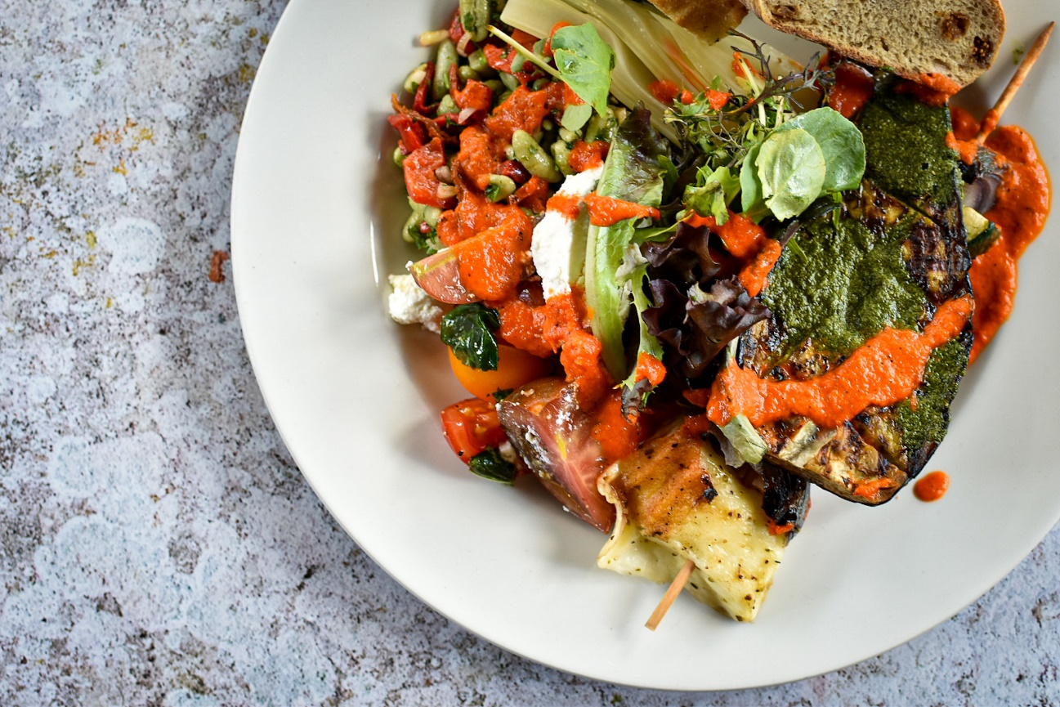
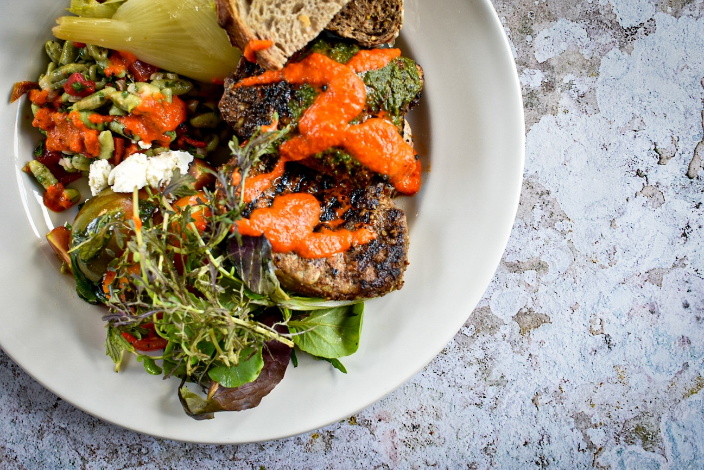
Barbecues
We have 2 BBQ options to choose from, these are our luxury BBQ or our everyday BBQ.
Minimum of 15 people – Everyday £22.24pp – Premium £31.68pp
Sample menus
Eastern Mediterranean Grill
Zaatar lamb chops & Lebanese chicken.
Dukkah aubergine steaks & marinated halloumi and courgette kebabs.
Complimenting seasonal compound salads.
Mixed leaf salad.
Variety of fresh and dried artisan breads.
Table condiments such as sauces, pickles & chutneys.
Supplementary
Homemade desserts – additional £4.45pp.
Everyday BBQ
Alden’s beef burger & jerk chicken.
Falafel burger & vegetable kebabs.
Complimenting seasonal compound salads.
Mixed leaf salad.
Variety of fresh and dried artisan breads.
Table condiments such as sauces, pickles & chutneys.
Supplementary
Homemade desserts – additional £4.45pp.
@st_annes_kitchen
All menus are subject to VAT at the prevailing rate

Slide 14
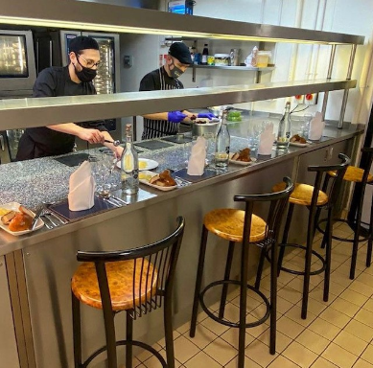
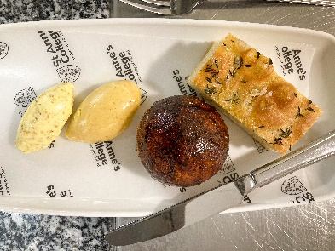
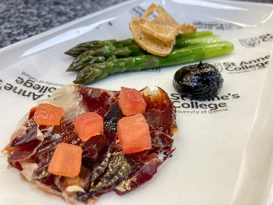
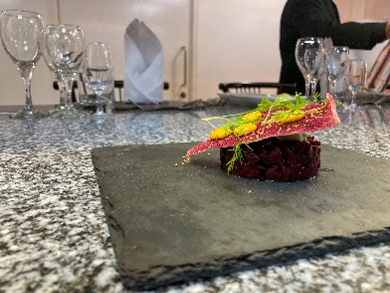
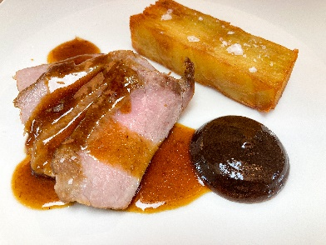
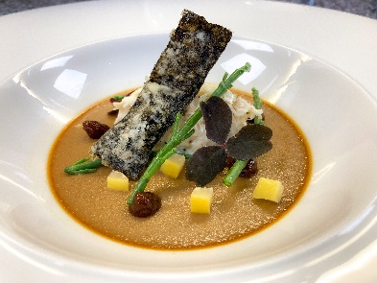
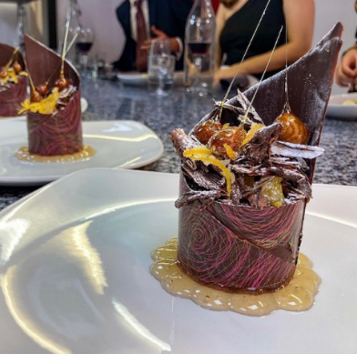
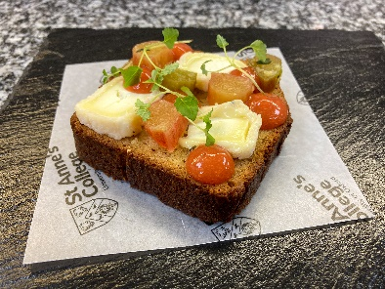
The Head Chef’s Tempters!
If you would like to make your visit to Oxford a little more special,
please see what we have to offer below.
Chefs Table
This is a 4 to 6 course meal with paired wines. Dine exclusively inside our Ruth Deech kitchen whilst the chefs talk you through each course as they cook and plate up a bespoke tasting menu in front of you and your guests. As part of the experience, your menu will not be revealed to you until you arrive at the kitchen.
Maximum of 6 people. Prices are £78.95 for 4 courses & paired wines per person and £113.42 for 6 courses & paired wines per person.
Please ask our Conference and Events team for more details.
Sample menu
Fresh breads.
Iberico Jamon, tomato, local asparagus, black garlic, sourdough croutons.
Beetroot tartare, cured egg yolk, whipped goat cheese.
Seaweed set custard, fennel crème crab, samphire, nori cracker.
Presa Iberica, thousand layer chips, membrillo & pickled walnut ketchup..
Brown butter brioche, Brefu Bach, rhubarb, lemon balm.
Chocolate mousse, chocolate & hazelnut soil, poached orange, PX reduction.
Coffee.
St Anne's Catering Brochure 2021
@st_annes_kitchen
All menus are subject to VAT at the prevailing rate

Slide 15
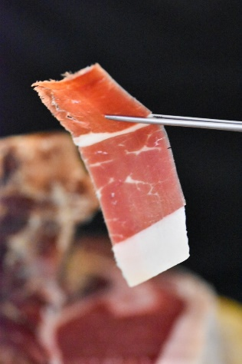
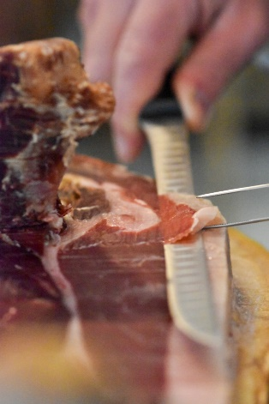
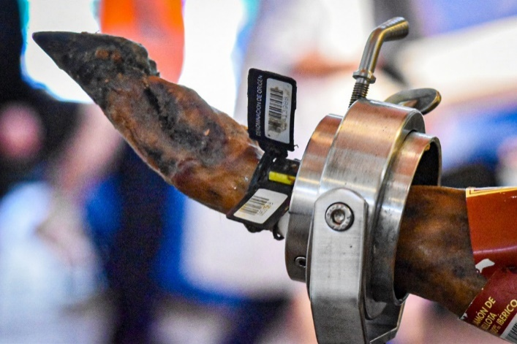
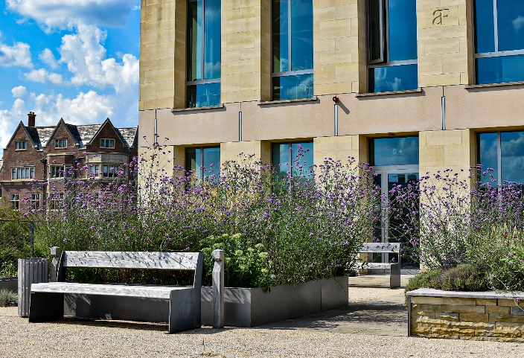
The Head Chef’s Tempters!
Iberico Jamon
To accompany your drinks reception:
Iberico Jamon sourced from Huelva in Andalucía, carved in front of you by a specialist jamon cortador from Oxfordshire Spanish Ham Experience. If this is something you wish to consider we would require you to pre order 4 weeks in advance. Prices are per whole jamon of which one will serve 80 to 100 guests.
Eiriz cebo de campo £700.
Eiriz Bellota 100% £1000.
Exclusive summer dining on our roof garden
To make your visit to Oxford a little unique
You can choose from the hot or cold grazing table, working lunches or drinks reception with pintxo.
Maximum of 10 to 20 people.
Exclusive hire of the roof garden start from £100.00
Please speak to our Conference and Events team if you would like to have any of the VIP extras and they will be happy to help and advise you.
St Anne's Catering Brochure 2021
@st_annes_kitchen
All menus are subject to VAT at the prevailing rate

Slide 16
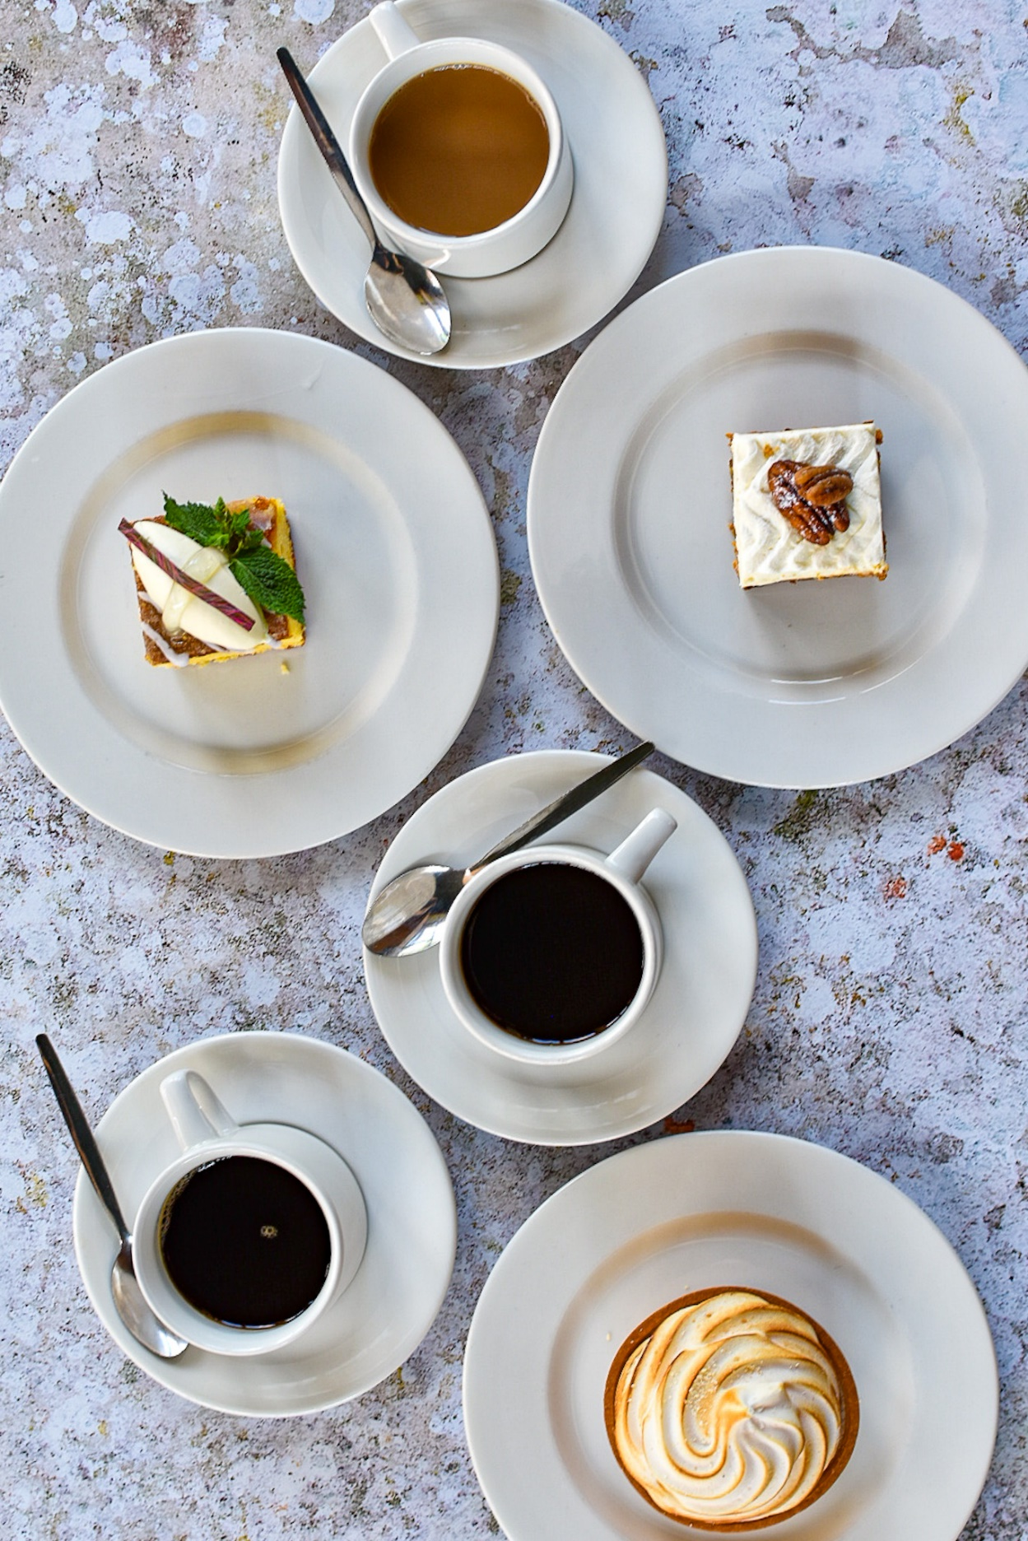
Liquid Refreshments
Tea & coffee - £2.39/person
Tea & coffee with biscuits - £3.97/person
Tea & coffee with cake - £6.84/person
Tea & coffee with Danish pastries - £6.84/person
Tea & coffee with scones, jam & cream - £6.84/person
Fruit bowl - £1.89/person
Cut fruit platter - £3.18/person
St Anne's Catering Brochure 2021
@st_annes_kitchen
All menus are subject to VAT at the prevailing rate

Slide 17
STACS
Monday – Sunday
Open 6pm – 8pm (Pre – booked)
Dear Conference Organiser,
Have you heard about STACS, our coffee shop on site, we sell homemade pizzas and are proud to say our sourdough bases are sustainably sourced by Italian food specialist Stefano Vallebona from Vito who is based a few miles from Bari and has been producing high quality pizza for two decades. Besides our pizzas we also have paninis, toasties, an assortment of cakes, a selection of coffees and teas and a small selection of bottled beers, wines and soft drinks.
If you feel that your delegates may like to make use of this facility in the evenings, if you haven’t any pre-arranged dinners planned, please let the Conference & Events team know at the time of booking and we will happily open this facility for you and your delegates. (Please note – there will be a £50 deposit for this option that will be refunded if delegates make purchases to this amount) STACS will be open from 6pm – 8pm (or times that suit you) for either eat-in (limited seats available) or takeaway for food and drink purchases but can remain available after these times for you to continue to sit and relax. Payments can be taken from individual delegates by card (credit/debit), St. Anne’s is a cash free college, or if you would like the cost added to your main invoice this is also an option.
Please note, as previously mentioned, STACS will only be open if booked in advance of the commencement of your conference and please remember to advise us if the cost is to be added to your main account or your individual delegates are to be charged.
We look forward to seeing you and your delegates soon,
St. Anne’s Catering Team

Slide 18
STACS
Monday – Sunday
6:00pm – 8:00pm
(Pre – booked)
Please note all prices are VAT inclusive
Stone baked sourdough Pizza.
Margherita £8.00
Choose your own toppings all £0.75
Pepperoni
Halal BBQ chicken
Ham
Tuna
Onion
Peppers
Olives
Pineapple
Fresh tomato
Sun blushed tomato
Mozzarella
Proscuitto
Rocket
Vegan cheese
Beers/Wine/Soft Drinks.
Prosecco Amori 200ml £6.00
Pinot Grigio, R&R (Qtr) £4.00
Sauvignon Blanc, R&R (Qtr) £4.00
Cabernet Sauvignon, R&R (Qtr)£4.00
Shiraz, R&R (Qtr) £4.00
Becks Beer 330ml £3.50
Beaver Beer 500ml £4.00
Kopperberg cider 500ml £4.50
Heineken Non Alcoholic 330ml £2.50
Coke bottle £1.90
Harrogate still water £1.00
Luscombe ginger beer £2.50
Luscombe Sicilian Lemonade £2.50
Elderflower Presse £2.50
Hot drinks.
Americano £2.00/£2.50
Espresso £1.80/£2.30
Capuccino £2.50/£2.90
Latte £2.50/£2.90
Mocha £2.50/£2.90
Tea £1.80
Hot chocolate £2.50
Pizza by slice.
Stone baked on Vallebona sourdough bases.
Pepperoni £2.50
Margherita £2.50
Today’s special £2.50
Cakes / Pastries.
Brownie / slice (chilled) £2.00
Muffins £1.40
Cookies £1.30
GF cookies £1.30
Flapjack/slice(ambient)£1.90
Toasties’.
Ham & cheese £2.50
Cheese & tomato £2.50

Slide 19
College Bar
Dear Conference Organiser,
The College bar can be requested prior to your event taking place, giving your delegates a place to chill out together in a unique student bar environment!(Please note – there will be a £50 deposit for this option that will be refunded if delegates make purchases to this amount)
It has an extensive range of draught and bottled beers, spirits and soft drinks, at prices cheaper than the local pubs, which can be supped whilst challenging colleagues to a game of pool, table football, darts or just chilling watching tv or listening to the juke box.
The bars normal opening hours are 1900 – 2300hrs with 20 mins drinking up time, however we can offer flexible opening (booked prior to the start of your event), for example you may want to offer your guests a pre-dinner drink before dinner rather than giving a more formal drinks reception.
There is the option of either adding the cost of the drinks to your main account/invoice or if you prefer and funds are tight, we can take payment from your individual guests via credit/debit card only as we are a cash free College.

Slide 20
Wine list 2022
WHITE WINE
Bella Modella ‘La Farfalla’ Pinot Grigio IGT – Italy - £13.00
Beautifully light & vibrant. Its zesty, citrus & green apple character with a refreshing quality
De Bortoli, The Accomplice Chardonnay – Australia - £13.50
Warm fermentation & a wide variety of yeast strains used to add complexity & texture. Clean, lean & unoaked
Picpoul de Pinet, Domaine la Serre – France - £16.70
Crisp dry palate, notes of peach, melon & grapefruit with zesty acidity & an intense minerality giving a long refreshing finish
Honu Sauvignon Blanc – New Zealand - £17.00
Fresh, crisp and zesty with aromas of citrus and passion fruit, combined with intense flavours of lime and gooseberry
RED WINE
Montaignan Carignan Vieilles Vignes – France - £13.50
Typically juicy, lots of delicious red fruits, a lick of oak adding vanilla, & soft tannins at the finish
El Tesoro Malbec – Argentina - £16.00
Aromas ripe black fruit, leather & tobacco spice. Full bodied flavours blackberry, damson spice & notes pepper & cinnamon
Paparuda Pinot Noir – Romania - £13.75
Delicate fruit aromas strawberry, redcurrant & raspberry with a wisp of savoury smoke. Elegant palate with fine tannins
Zensa Primitivo – Italy - £18.75
Complex bouquet, reminiscent of cherries, dried berries & toasted almonds. Full bodied yet smooth & elegant with a silky texture

Slide 21
Wine list 2022
SPARKLING & CHAMPAGNE
Prosecco Amori – Italy - £16.70
Fresh & vibrant with notes of crisp apple & peach. Fruity & gently off dry
Joseph Perrier Yellow Label Brut NV – France - £57.70
A good characterful champagne offering white flowers and honeyed notes, a fine mousse, a full fruity flavour and a toasty finish.
All wines sold on sale or return
A premium wines list is available on request
BAR LIST
Heineken Non Alcholic Beer 330ml - £1.67
Beck’s 330ml - £2.92
Beaver Beer 500ml - £3.34
Kopperberg Mixed Fruit Cider 500ml - £3.75
Jug of Pimms 1.5L - £15.84
SOFT DRINKS
Elderflower Presse 275ml - £2.09
Luscombe Ginger Beer 270ml - £2.09
Luscombe Sicilian Lemonade 270ml - £2.09
Jug of Orange Juice 1L - £2.50
Please note all prices are exclusive of VAT

Slide 22
Charges 2022-2023
All prices are subject to VAT at the prevailing rate
BED & BREAKFAST
Non Ensuite Room £56.70
Ensuite Shower Room £89.25
Twin Ensuite Room £147.00
VISUAL AIDS
Data Projector £75.00
Laptop £75.00
College Posterboards £10.00
24-Hr Rate Ensuite £151.00
24-Hr Rate Standard or with Washbasin £119.00
LECTURE / SEMINAR ROOMS (PER DAY)
Mary Ogilive Theatre (inclusive of basic AV) £750.00
Tsuzuki Lecture Theatre (inclusive of basic AV) £560.00
Danson Room £210.00
Seminar Room 1 (inclusive of plasma screen) £220.00
Seminar Room 3 £150.00
Seminar Room 4 £110.00
Seminar Room 5 (inclusive of plasma screen) £220.00
Seminar Room 6 (inclusive of plasma screen) £180.00
Seminar Room 7/8 (inclusive of plasma screen) £280.00
Seminar Room 9 £220.00
Seminar Room 10/11 (inclusive of plasma screen) £280.00
Outreach Room/Roof Garden (inclusive of plasma screen) £230.00
Research Office 2 £110.00
HYBRID EQUIPMENT
OWL Device for Seminar Rooms £200.00
Mary Ogilvie Hybrid Equipment £450.00
Tsuzuki Hybrid Equipment (available from Dec 22’) £450.00
BREAKFAST
Working Breakfasts £13.34
LIQUID REFRESHMENTS
Tea & Coffee £2.39
Tea & Coffee with Biscuits £3.97
Tea & Coffee with Cake £6.84
Tea & Coffee with Danish Pastries £6.84
Tea & Coffee with Scones, Jam & Cream £6.84
Fruit Bowl £1.89
Cut Fruit Platter £3.18
ALL DAY
Cold Grazing £22.24
Hot Grazing £22.24
Sandwich Trays £13.34
Tapas Trays £16.68
Supplementary Desserts £4.45
PRE DINNER
Pintxo’s 3 per person £10.03
Pintxo’s 5 per person £16.68
Nibbles £5.58
DINNERS
Family Service Dinner 2 Course £26.68
Family Service Dinner 3 Course £37.84
Fine Dining 3 Course £56.45
BARBECUES
Everyday Barbecue £22.24
Eastern European Grill £31.68
HEAD CHEFS TEMPTERS
Chefs Table 4 Course including paired wine £78.95
Chefs Table 6 Course including paired wine £113.42
Iberico Jamon Eiriz cebo de campo £700.00
Iberico Jamon Eiriz Bellota 100% £1000.00
Exclusive Summer Dining Roof Garden Hire £100.00
DRINK RECEPTIONS
Champagne Reception £30.00
Sparkling Wine Reception £10.00
Red & White Wine Reception £9.00
SUPPLIMENTARY
Heineken Non Alcoholic Beer 330ml £1.67
Beck’s 330ml £2.92
Beaver Beer 500ml £3.34
Kopperberg Mixed Fruit Cider 500ml £3.75
Jug of Pimms 1.5L £15.84

